Slide 1
ADVANCED REACT
State Management – Global techniques

Slide 2
OBJECTIVES
In this module, you will
Be introduced to the state management options in React
useContext
reduxjs toolkit
Understand state uplifiting
Investigate React Query Library for data caching

Slide 3
When our creations become too big to manage, we often turn to external libraries and techniques to help us solve the problems
With state, there are 2 front running solutions that can be implemented to help up control the flow of state, and avoid the huge pitfall of ‘Prop Drilling’
Those are using useContext() – we will use our shop app and build a shopping cart using context as a simple example of how this works
We will also learn how Redux works. This is an external library, and takes a little more setup. But you will recognise it is an extension of the hooks we looked at earlier in the week
The need for Global state management

Slide 4
useContext()

Slide 5
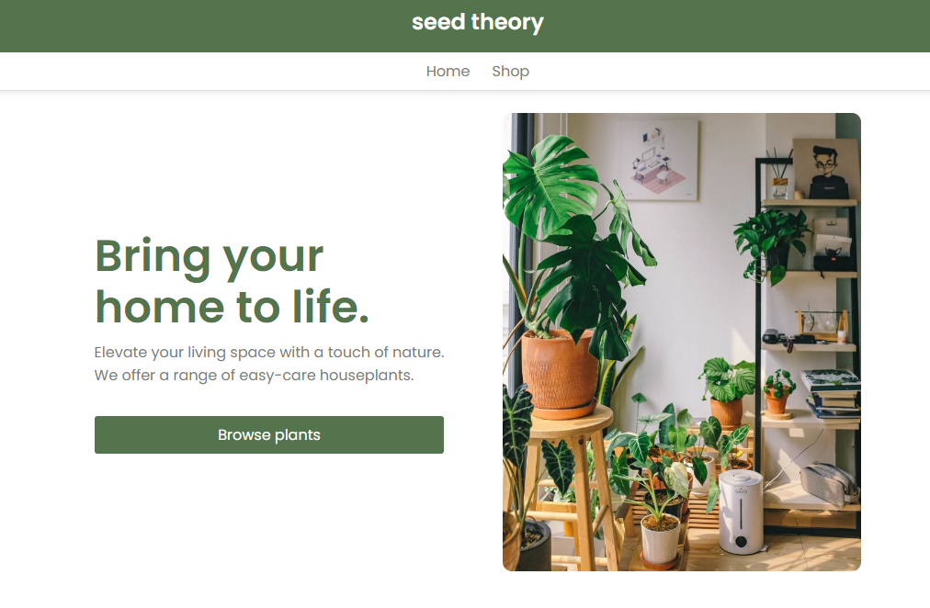
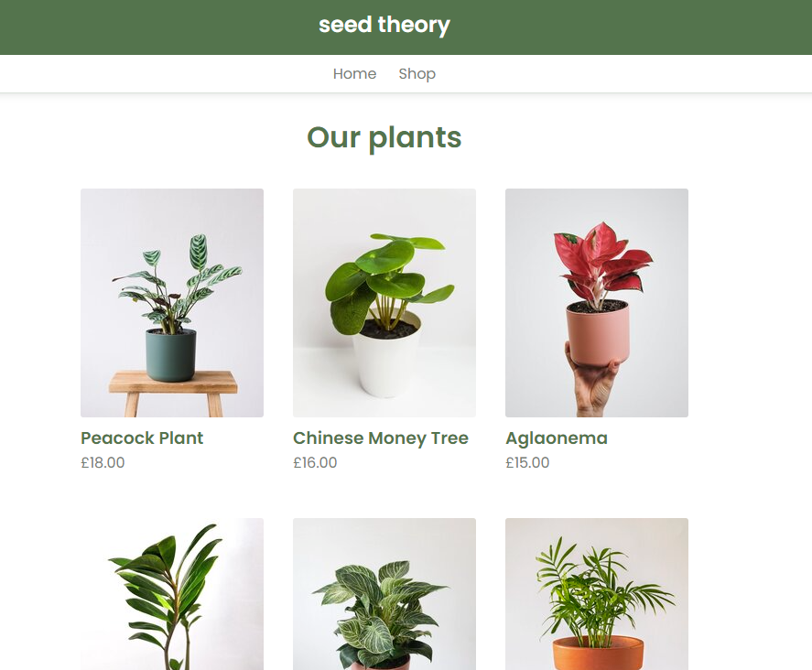
You will all be at different points with your flower/plant shop app.
Our Starting Point
Notes:
This contains the starting code and the final product with working context (in the form of a cart)
AndySmithQA/flowers (github.com)

Slide 6
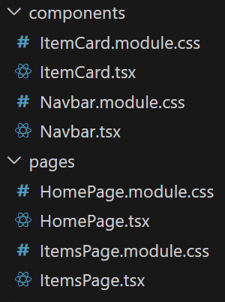
We start with just 2 pages, but the structure will demonstrate another way to build your app by breaking the concerns up in a microservice style
The components and pages are separated along with the CSS for each of those sections
Our Starting Point

Slide 7
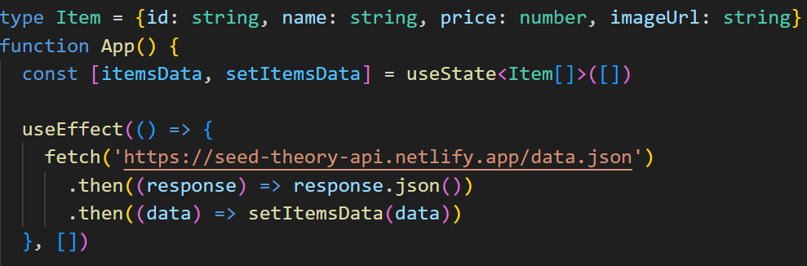
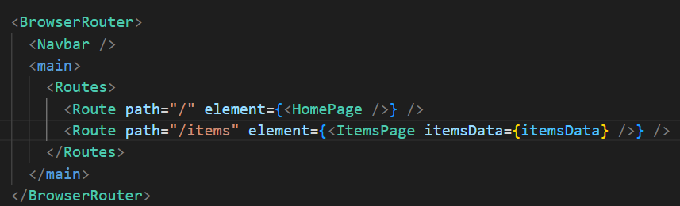
The items are pulled in using an API and then passed to the components to build the page
We have also use BrowserRouter in this example
Our Starting Point
Notes:
'https://seed-theory-api.netlify.app/data.json'

Slide 8
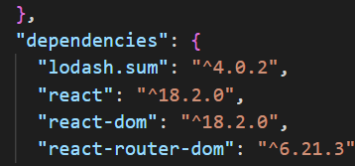
If you look at package.json, you will see that I have installed lodash.sum
This is a very helpful library that simplifies working with number, arrays and objects.
Our Starting Point
Notes:
Lodash makes JavaScript easier by taking the hassle out of working with arrays, numbers, objects, strings, etc.Lodash’s modular methods are great for:
Iterating arrays, objects, & strings
Manipulating & testing values
Creating composite functions

Slide 9
We want to create some buttons on the items page that allow us to add one of those items into our shopping cart
We will do this by building a CartContext which contains all of the relevant states and functions to allow this to happen.
Wrapping the app in this context will allow us to pass the data between components efficiently
Shopping cart

Slide 10
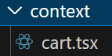
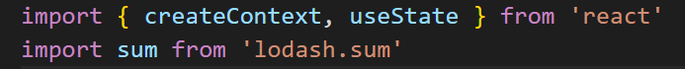
Create a new folder called context in your src folder.
In here, create a cart.jsx file
As always, we need to do some imports. Here we can import createContext and useState.
We will also import sum from ‘lodash.sum’
Shopping cart

Slide 11
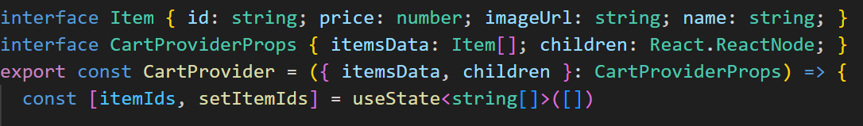
We want to create the new context and create the CartProvider export. Notice that we want to accept the children, along with the item data so that we can receive info back up the tree
First, we want to keep track of the items the user has put into the cart. We do with a piece of state called itemIds
This starts out as an empty array
Shopping cart

Slide 12
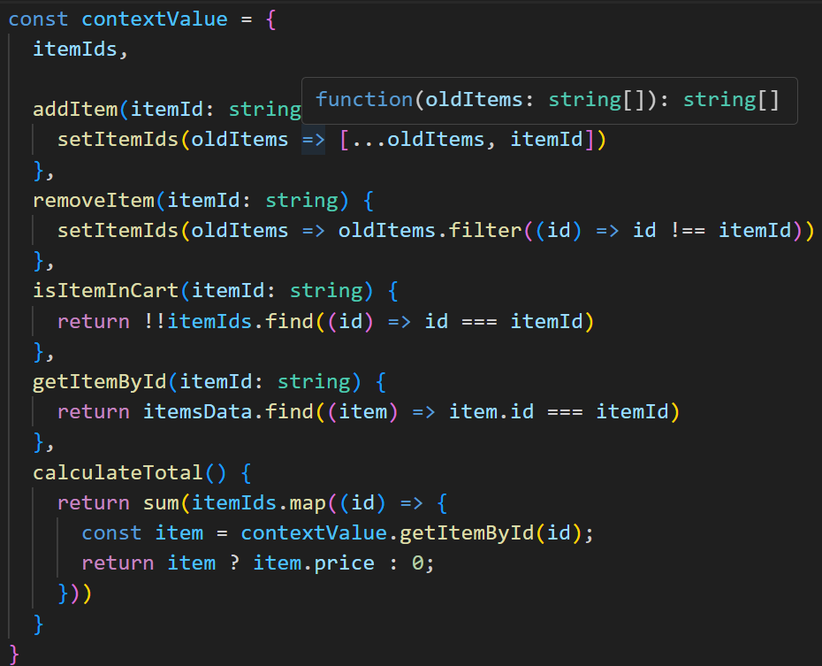
Next, we need to build the functionality (actions) that this context will provide. This functionality will wrap and be passed to all components that can access the provider
Shopping cart

Slide 13
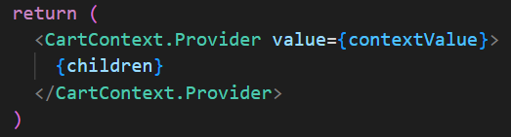
The return simply identifies the provider and passed the ids of the items in the cart and the functionality available to the children
Shopping cart

Slide 14
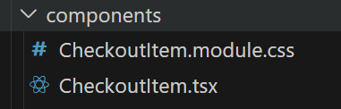
We want each of the items it the cart to be displayed. Not only is this good ux for the user, it helps the developers visualise how the cart is going to function
The checkout page will have a child called CheckoutItem and we will build this first
Create a new component and also a new modular CSS file for it
The checkout page

Slide 15
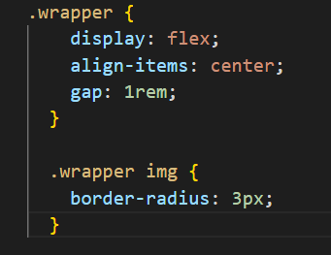
The CSS is broken up and is less important than the code itself at this point
The checkout page
Notes:
.wrapper {
display: flex;
align-items: center;
gap: 1rem;
}
.wrapper img {
border-radius: 3px;
}

Slide 16
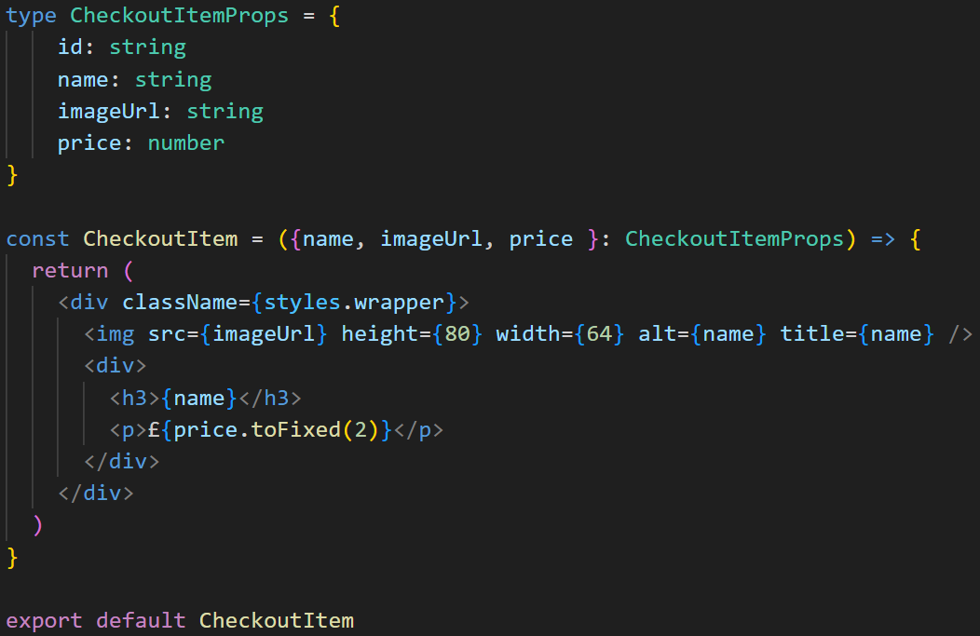
Inside CheckoutItem.jsx, we need to import the CSS file and build a card style element to display what is in the cart
Don’t forget that much of the basis of this data will come from the context
The checkout page

Slide 17
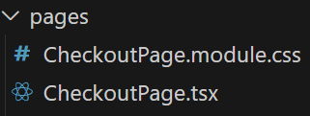
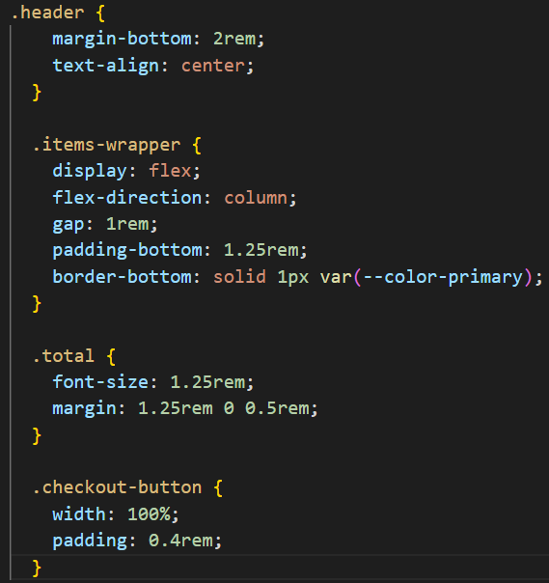
The checkout page itself will require some imports. Firstly, lets build the page and apply the CSS
The checkout page
Notes:
.header {
margin-bottom: 2rem;
text-align: center;
}
.items-wrapper {
display: flex;
flex-direction: column;
gap: 1rem;
padding-bottom: 1.25rem;
border-bottom: solid 1px var(--color-primary);
}
.total {
font-size: 1.25rem;
margin: 1.25rem 0 0.5rem;
}
.checkout-button {
width: 100%;
padding: 0.4rem;
}

Slide 18
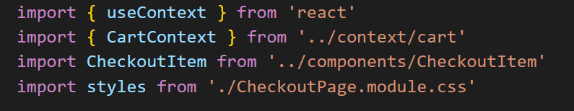
We need to import useContext to be able to unpack the CartContext
We need to import the cart context itself.
We need to import CheckoutItem
Lastly, import the styles
The checkout page

Slide 19
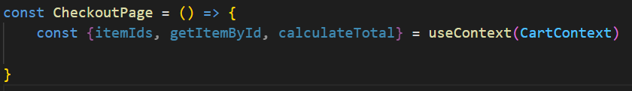
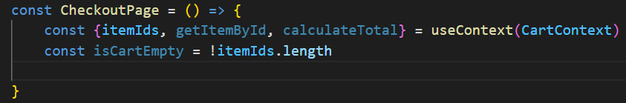
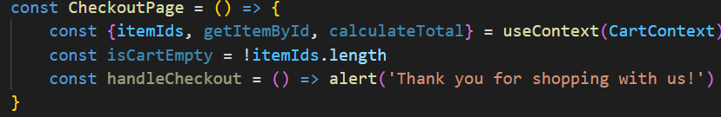
Now, we can unpack the content and the functionality from the CartContext
Add a Boolean to check if there are items in the cart
And put in a mock submission handler for the checkout
The checkout page

Slide 20
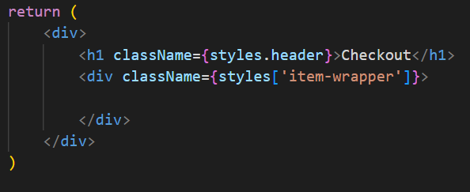
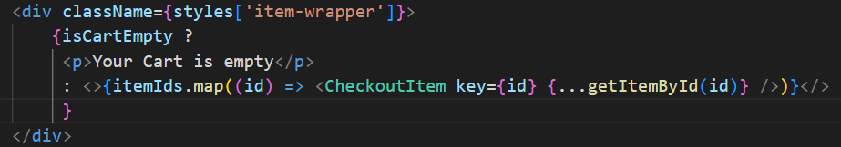
The return will check to see if there are items in the cart. If there are, it will pass the ids to the CheckoutItem child component to have them individually returned
Once ready, lets check to see if there are items in the cart
The checkout page

Slide 21
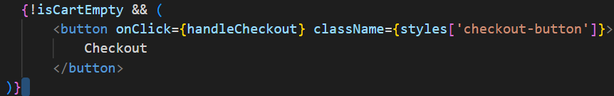
Regardless of whether there is anything in the cart, we want to display a total
We can also use conditional rendering to display a checkout button
This will call the functionality that would handle the submission of the checkout items
The checkout page

Slide 22
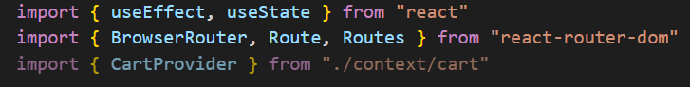
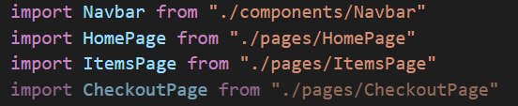
Firstly, we need to import the context into our app
Don’t forget the new CheckoutPage component as well
Add a route

Slide 23
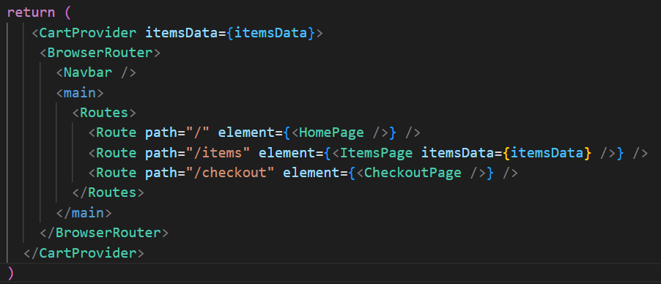
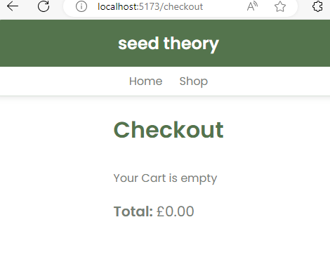
We wrap the BrowserRouter with the CartProvider context, passing in the items Data. Then add a new Route for the checkout Page
Navigating to /checkout gives us a page
Add a route

Slide 24
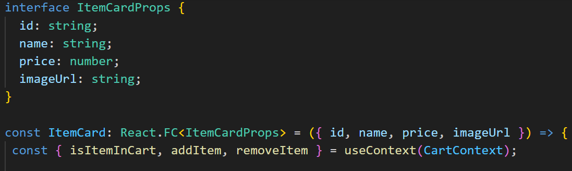
This is where the power of context shines through. We can add all the functionality and state to any other component, regardless of where it is in the tree
In ItemCard.jsx, import useContext and CartContext,
Destructure the functionality from the context
Adding Functionality

Slide 25
We need to add the items to the cart via the ItemCard.jsx Component. We will need to add a button which follows the following logic:
If the item is not already in the cart, add it
If the item is in the cart, remove it
We can also change the text on the button to reflect this too
Adding Functionality

Slide 26
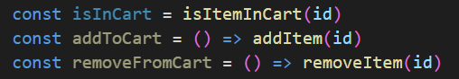
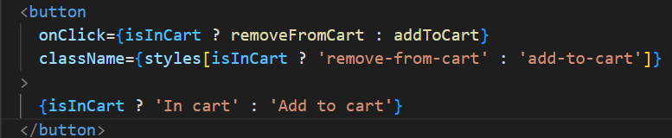
Add the local functionality
In the return, add in the button
Adding Functionality

Slide 27
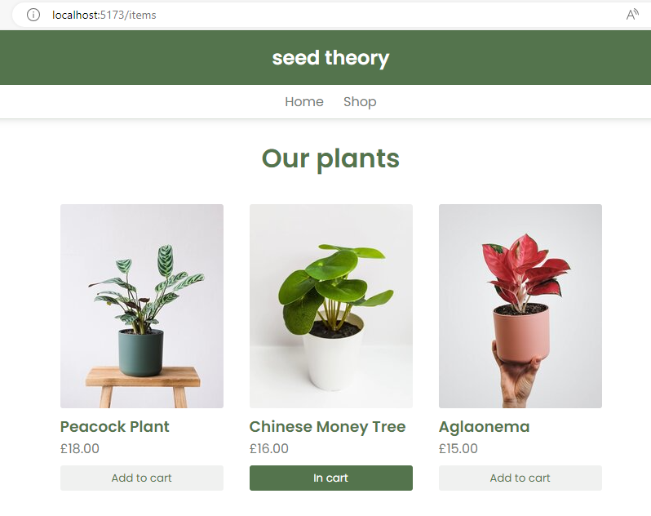
The buttons are now styled to reflect if they are inside the cart
Adding Functionality

Slide 28
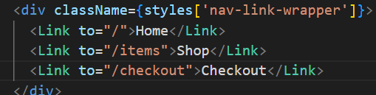
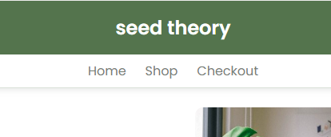
Lets add a link in the Navbar.jsx component
Adding Functionality

Slide 29
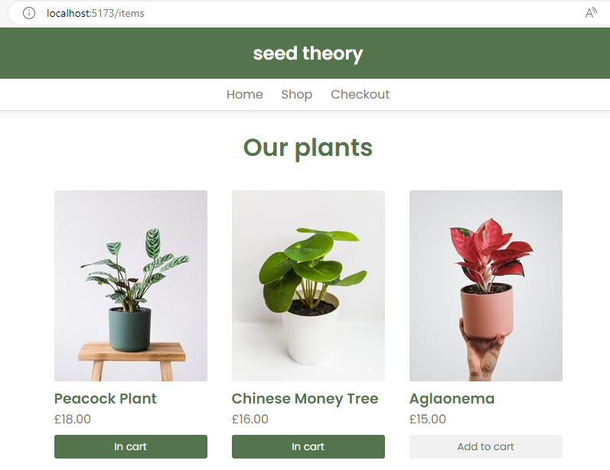
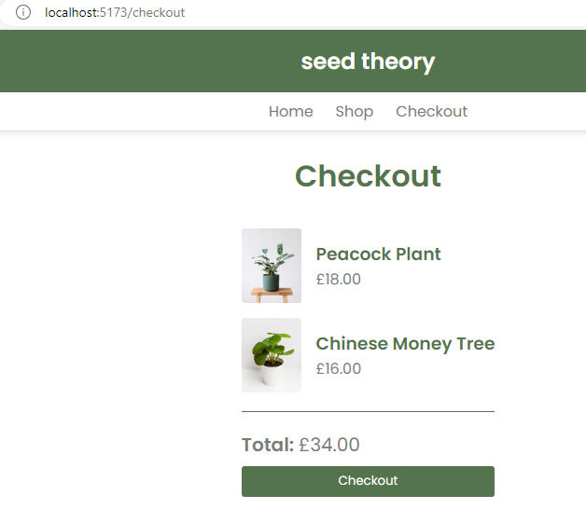
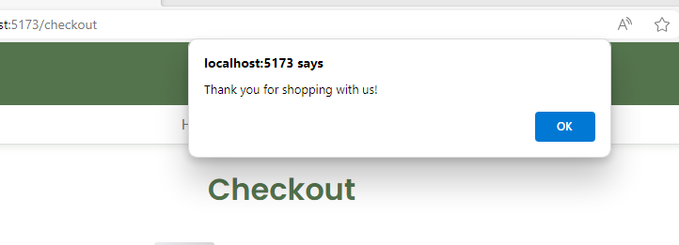
Now we can add items to the cart and view them in the checkout
Working Context

Slide 30
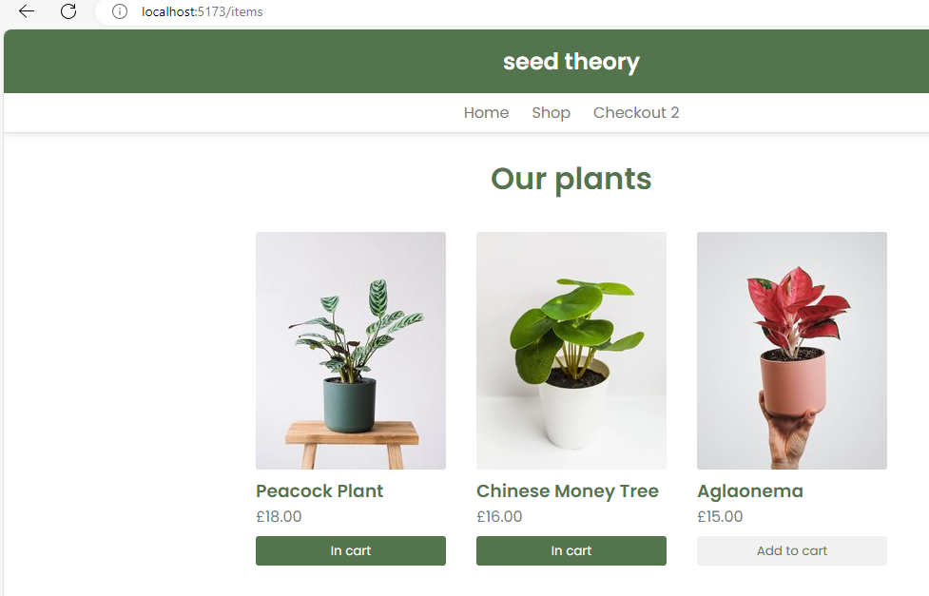
Can you add the number of items in the cart to the NavBar?
Quick Challenge

Slide 31
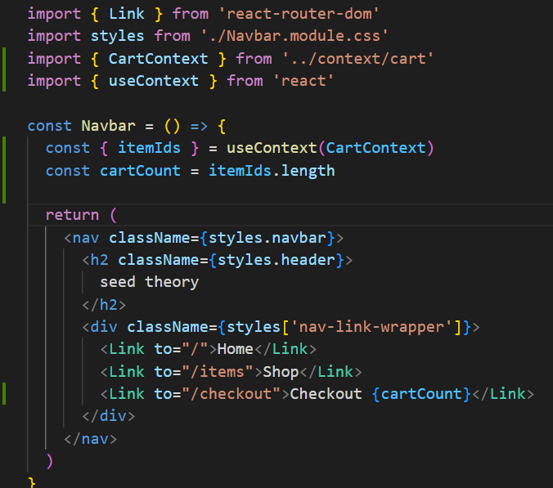
Can you add the number of items in the cart to the NavBar?
It’s very easy with Context
Quick Challenge
new

Slide 32
Redux

Slide 33
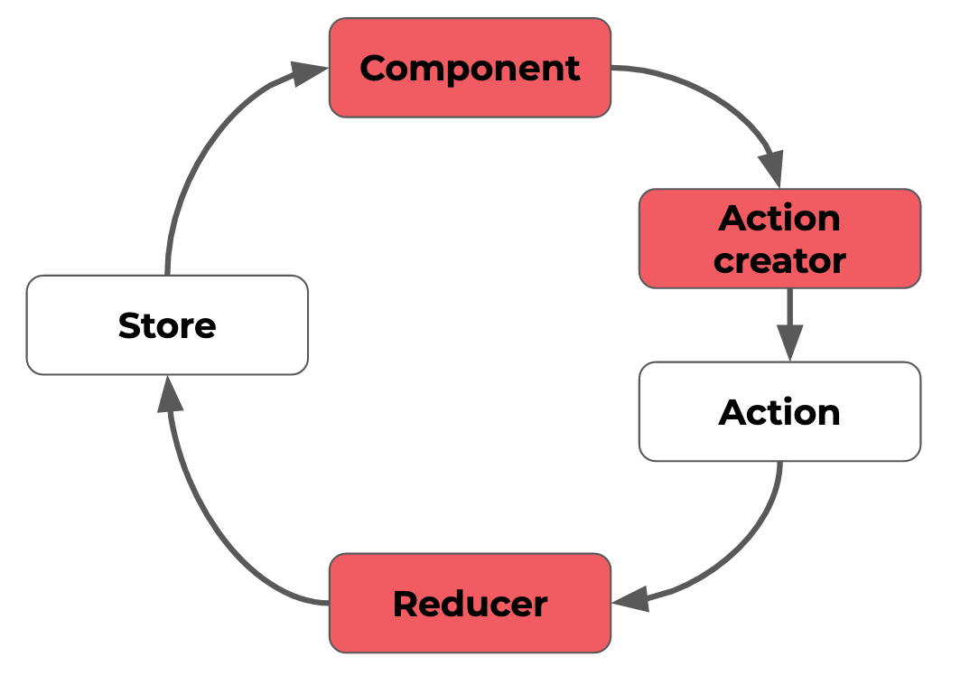
A very popular solution for Global state management is a library called Redux
It works very similarly to many of the hooks and techniques we have looked at over the past 3 days
The hardest thing to adapt in using this new library is the language we use to describe what is happening
Redux

Slide 34
The latest advice is to use @reduxjs/toolkit as this has been released to wrap a lot of the existing functionality
The complaint was that there were too many imports
It needs to be installed into our app, along with react-redux
The react-redux install gives us some tools that make react more efficient using redux
Redux Toolkit

Slide 35
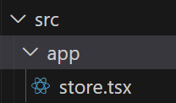
Inside the src folder, we will make a new folder called app, and in here a file called store.jsx
A store is a container which holds the global state in an immutable object tree.
It is recommended to have a single store for an app.
Setup

Slide 36
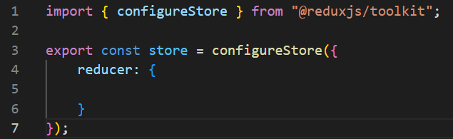
Start off by importing { configureStore } from the toolkit. (this replaced createStore in the older versions)
This store holds the configure store object. This will hold the reducers we create within the functionality
Come back to this later
Configuring the store

Slide 37
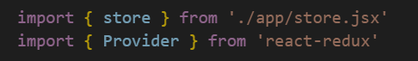
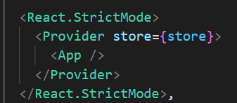
In main.jsx, we need to import the store and also Provider (similar to context)
This wraps the app
Now the global state is available to the entire app
The Provider

Slide 38
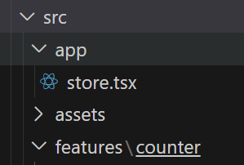
It is good practice to create a directory of the features your app will have. We will create a path of folders called features \ counter
In the counter folder, we need to create a slice
This splits up redux state objects into multiple slices of state
(A collection of features, actions and logic for an individual bit of functionality)
The Provider

Slide 39
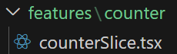
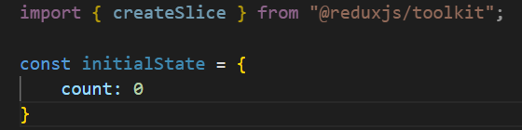
Inside the counter folder, we can create the counterSlice.tsx file to hold all the state and logic for the counter feature
Start with an import of createSlice. Then create an initial state where count = 0
The Slice

Slide 40
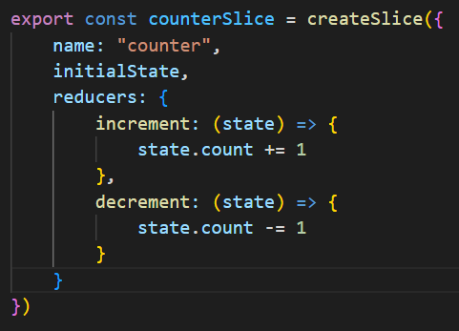
We now need to define the counterSlice which names the slice, initialises the state and then contains the logic.
To contain the logic, we use reducers (this looks very similar to useReducer())
The Slice

Slide 41
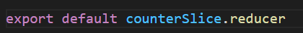
These actions need to be exported
Finally, we must export the reducer
These are now ready for use in components
The Slice

Slide 42
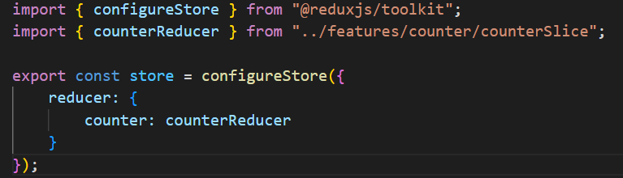
Back in our store, we import ted reducer
If we were to add new slices, we could easily import them into this store and distribute them under new names.
Now added to the store, it is available to the entire app via the provider in main.jsx
Importing the reducer into the store

Slide 43
Within the counter directory, we can create the component that uses this functionality.
Inside our component, we need to import some hooks from redux.
useSelector and useDispatch will allow us to talk to the store
We also need to import our actions (increment and decrement)
Creating the counter component

Slide 44
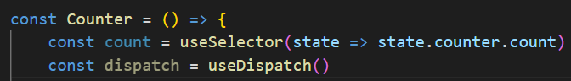

We define count locally and allow useDispatch to collect the actions
useSelector lets us pull specific bits of state out of the store
In the return, we can now use dispatch to fire when some buttons are clicked
Creating the counter component
Notes:
useDispatch HookThe main benefit of using **useDispatch** is that it provides a clean and simple way to dispatch actions from React components. It eliminates the need to pass the **dispatch** function down through props, which can be cumbersome and difficult to manage in larger applications.

Slide 45

In App.jsx, import the Counter component
Importing into App.jsx
Notes:
Style :
* {
margin: 0;
padding: 0;
box-sizing: border-box;
}
body {
min-height: 100vh;
font-size: 5rem;
display: grid;
place-content: center;
}
input,
button {
font: inherit;
padding: 0.5rem;
}
section {
display: flex;
flex-direction: column;
justify-content: center;
align-items: center;
}
input {
text-align: center;
max-width: 2.5em;
}
button {
font-size: 2rem;
margin: 0.5em 0 0.5em 0.5em;
min-width: 2em;
}
button:first-child {
margin-left: 0;
}

Slide 46


Counter works as Expected
Importing into App.jsx
Notes:
Style :
* {
margin: 0;
padding: 0;
box-sizing: border-box;
}
body {
min-height: 100vh;
font-size: 5rem;
display: grid;
place-content: center;
}
input,
button {
font: inherit;
padding: 0.5rem;
}
section {
display: flex;
flex-direction: column;
justify-content: center;
align-items: center;
}
input {
text-align: center;
max-width: 2.5em;
}
button {
font-size: 2rem;
margin: 0.5em 0 0.5em 0.5em;
min-width: 2em;
}
button:first-child {
margin-left: 0;
}

Slide 47

Now that it is all set up, adding new actions to the slice is very easy
Here, we have added a reset action, which sets count back to 0 and incrementByAmount.
Notice this takes in state and action, just like useReducer.
Adding more functionality
Notes:
Style :
* {
margin: 0;
padding: 0;
box-sizing: border-box;
}
body {
min-height: 100vh;
font-size: 5rem;
display: grid;
place-content: center;
}
input,
button {
font: inherit;
padding: 0.5rem;
}
section {
display: flex;
flex-direction: column;
justify-content: center;
align-items: center;
}
input {
text-align: center;
max-width: 2.5em;
}
button {
font-size: 2rem;
margin: 0.5em 0 0.5em 0.5em;
min-width: 2em;
}
button:first-child {
margin-left: 0;
}

Slide 48


Once exported, we can add them to the import in Counter.jsx
We also need to import useState to define the amount we increment by
Add our state
Adding more functionality

Slide 49

Create the reset all function
Not only do we want to resent our increment, but also the global state too
Adding more functionality

Slide 50

Add some more code to our JSX return
This is input field for how much we should increment by. This will always be a number as per or code block
This adds the amount in the input box to the global state
Adding more functionality

Slide 51



You can see the layout now
Final piece

Slide 52



You can see the layout now
Final piece

Slide 53
Redux Browser tool kit

Slide 54

Often, we need to use some tools to debug our applications.
We have seen the normal react tools, but there are extra extensions available specifically for Redux.
Redux Dev Tools

Slide 55


When this extension in installed (we have used Chrome), you can click and open it.
But this closes when you click away
Redux Dev Tools

Slide 56

Opening the console(F12) and selecting Redux will allow the menu to persist
Notice that the extension automatically observes the app when opened
Redux Dev Tools

Slide 57



When you now perform an action, this is logged and displayed in the tools
It monitors the state
And what has changed
Redux Dev Tools

Slide 58


Each new action is logged and you can replay them with the slider at the bottom
Redux Dev Tools

Slide 59

Sometimes, we include functionality that has no UI component. The Redux tools allow us to manually enter the commands
Redux Dev Tools

Slide 60
Redux Vs Context API

Slide 61
Seems a bit of a cop out….. But
It depends heavily on the individual needs of the software you are developing.
There are some pretty straight forward guidelines however
When to use either

Slide 62

When to
use
either

Slide 63
React Context API is a simpler solution suitable for smaller applications with simple state management needs, while Redux is a more powerful solution suitable for larger and more complex applications with advanced state management needs.
When to use either

Slide 64
Caching Options in React

Slide 65
As already discovered, we can implement useCallBack and useMemo to reduce the calculational overheads within our software
We can use external libraries to make this make the caching of data even more reliable
TanStack are the organisation responsible for the maintenance of react-query.
In effect, all the processes have been reduced into a single hook which not only stores the data for a fetch, but manages caching operations too
Data caching for optimised performance

Slide 66


Simple Demo:
You will be provided with a repo of the following code and we will code the react-query code together
You should be able to clone the repo:
npm I
npm run dev
And navigate between the pages
TanStack: react-query
Notes:
AndySmithQA/tandemo (github.com)

Slide 67

You will see a db.json file which has some Cars
TanStack: react-query

Slide 68

We start with some routes which have been dropped into a RouteProvider to allow for some simple navigation
TanStack: react-query

Slide 69
Lets start by installing the tools from Tanstack
We can now start to utilize the tools we need
Like context, we will create a query provider and will wrap the App inside it.
Lets import the tools first inside App.jsx
installs

Slide 70


The QueryClientProvider is the wrapper and the QueryClient is what allows the library to perform the functions.
We have to build a queryClient (just like Context)
This then wraps the App
installs

Slide 71

Make the JSON available to the Heroes.jsx component.
In a new terminal window
JSON

Slide 72
Now that we have access to the data, we need to start using react-query to pull in the data, cache it and display it
First we need to import useQuery
Now we can build the fetch inside the useQuery const. We will destructure the content to be used throughout the component
Cars.tsx

Slide 73

Inside the Cars function build the useQuery
isLoading is a Boolean that reports when the initial data is being pulled into the page
(isFetching also exists and we will look at this too)
error holds any error codes
data is that data that is returned from the fetch
Cars.tsx

Slide 74
When useQuery fires, it caches the data in the queryKey. In this case, we have named it ‘heroes’ and have made it an array
queryFn is the function that is called when useQuery is fired. In this case, it fetches data from our JSON file
We will simulate the slow loading to see the loading content and see it being cached
Cars.tsx

Slide 75

This will allow us to pull content in when the Cars link is clicked
Cars.tsx

Slide 76

To see how this is working under the surface, we need to install the ReactQueryDevtools
We can then import it in App.jsx and add it under the RouteProvider
Devtools

Slide 77


When you fire the app up, you will see a button at the bottom of the webpage
Devtools

Slide 78


Notice that when you open the home page, there is no query
It’s only when the cars page is opened that you can see the data
Devtools

Slide 79

We can on the data and see information on the queryKey and see information about it
Devtools

Slide 80


If we open the browser tools and go to network, we can throttle the speed to fast3G
Pressing ctrl + f5 will clear the cache and perform a hard reset.
You will see the loading div
Devtools

Slide 81
But go to the home page and then back to Heroes, and there will be no loading as the content has been cached (default is 5 minutes)
Change the data in the json file and you will see the original data on the website. Clicking home, the heroes will then force a refetching as react-query knows the data has changed
Devtools

Slide 82
Challenges

Slide 83
Challenges
In your pairs, update your webpages to include the new features we have investigated.
If needs be, create a new project to integrate the features you want

